Slide 1
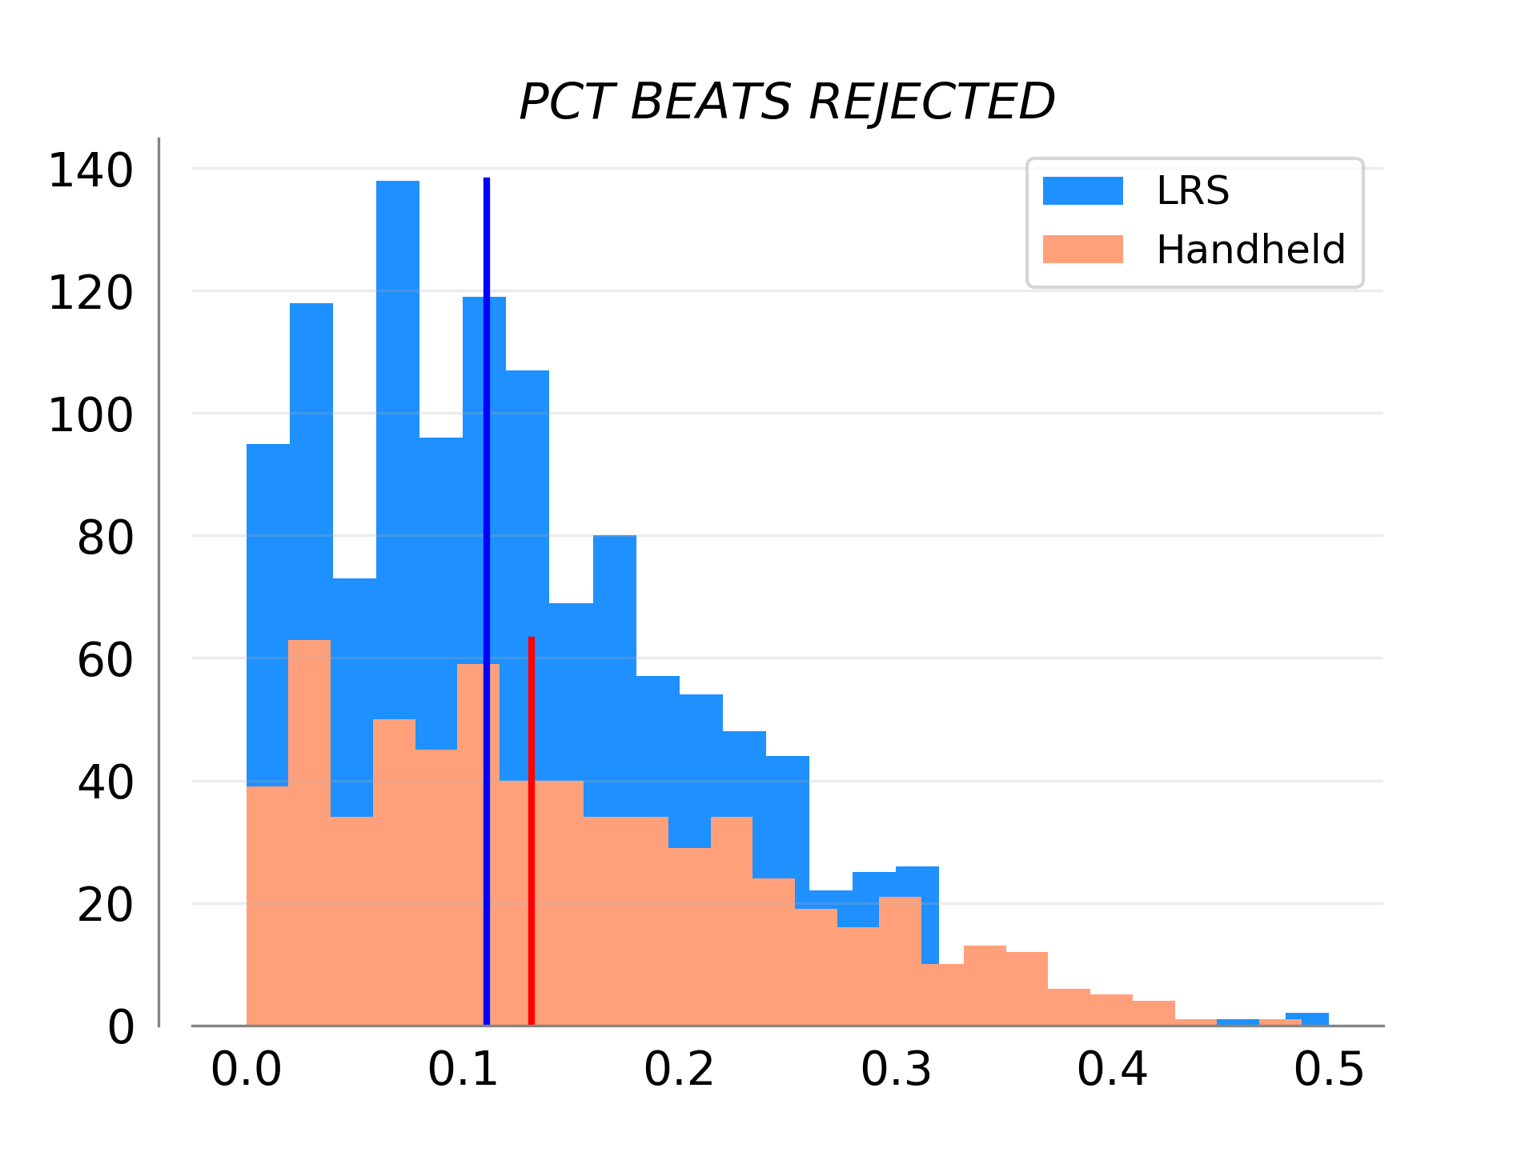
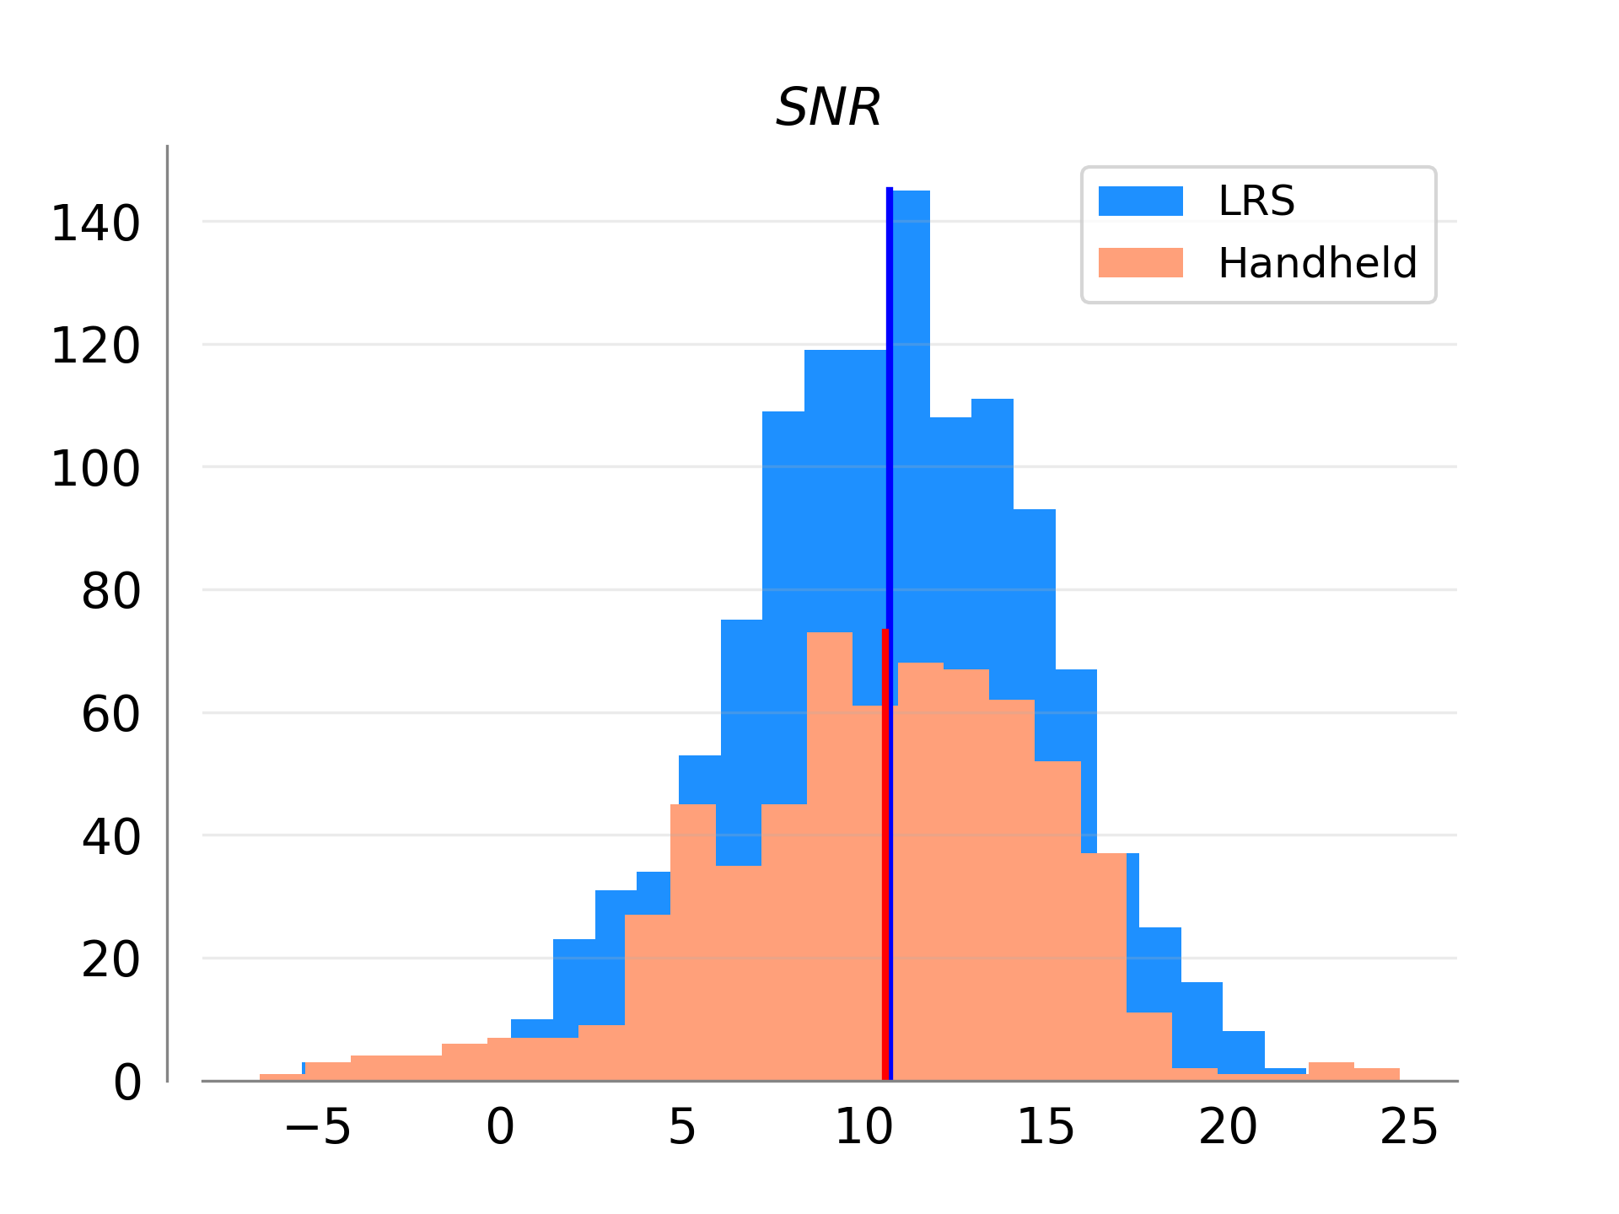
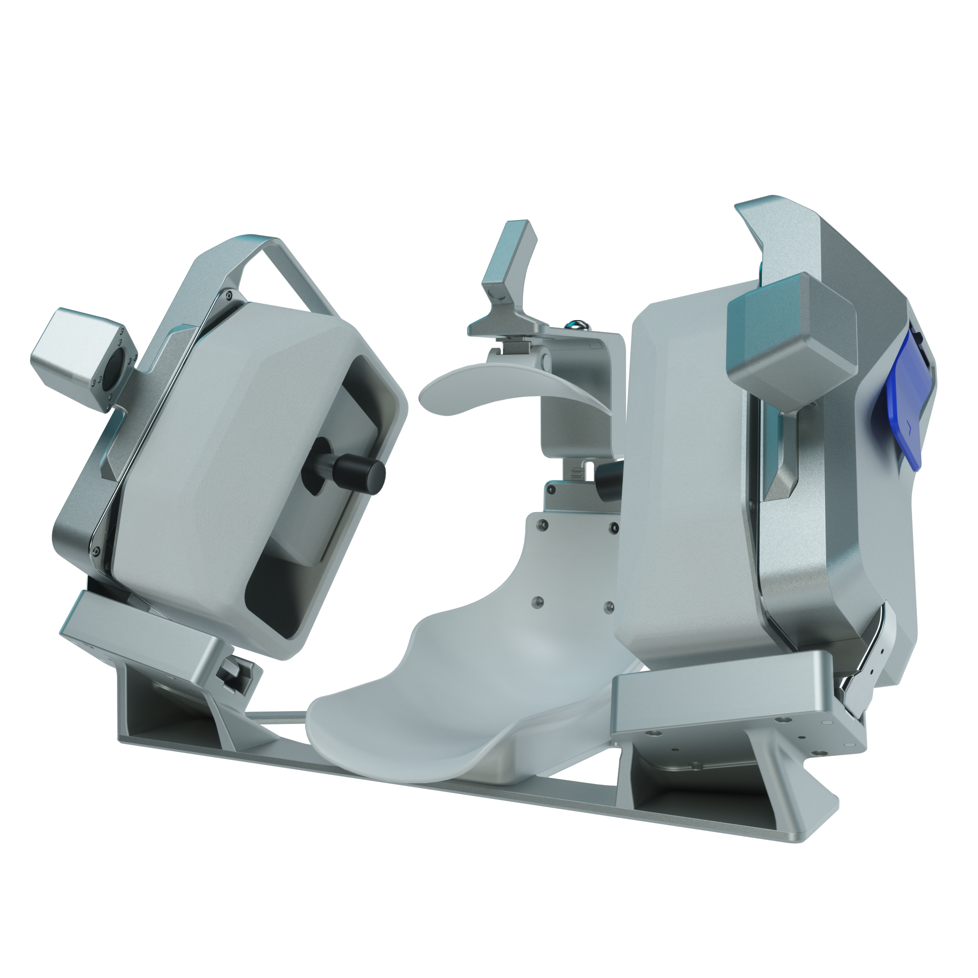
Comparison Of Transcranial Doppler Signal To Noise In Human And Robotically Acquired Clinical Control Groups
Samuel G. Thorpe¹ │ Corey M. Thibeault¹ │ Kian Jalaleddini¹ │ Nicolas Canac¹ │ Amber Y. Dorn¹ │Thomas Devlin² │ Robert Hamilton¹
¹ NovaSignal, Corp. Los Angeles, CA. ² Erlanger Neuroscience Institute. Chattanooga, TN
Introduction
Methods
results
High training requirements for ultrasound technicians have long been an obstacle to widespread adoption of TCD for acute stroke assessment, despite its status as a noninvasive, inexpensive, and conveniently portable imaging technology.
Collection and assessment of TCD exam signal quality is dependent upon the expertise of the person performing the exam, introducing a level of subjectivity that may vary across users and amount of experience.
Statistical Analysis
Notably, the proportion of rejected signal averaged 12% (SD=9%) for NovaGuide recordings, compared to 14% (SD=10%) for manual recordings, with observed group differences exceeding threshold significance (p<0.01).
We express the power of the residuals in terms of Signal to Noise Ratio (SNR):
$$SNR \left(dB\right)=10\log_{10}\frac{P_{signal}}{P_{noise}}$$
Where P is the power defined as the sum of the squared samples of a signal:
$$P_{x}= \sum_{k=0}^{n}{x^{2}\left(k\right)}$$
NovaGuide
Purpose
To assess signal quality for each recording, both SNR, and the proportion of each recording rejected as artifact, were computed and subsequently compared across groups via bootstrapped empirical p-values, with a critical level of 0.05 specified for significance.
In this work we compare TCD signal quality measured by an expert human sonographer to that acquired robotically with NovaGuide, a device which automates TCD data acquisition, in a clinical control population.
Figure 3. Distribution of rejected beats for NovaGuide and handheld TCD recordings.
Methods
Patient Population and Data Collection
results
conclusions
Subjects were enrolled at Erlanger Medical Center (Chattanooga, TN, USA), as part of an ongoing TCD study of large vessel occlusion (LVO).
To ensure that the presence of LVO did not impact signal quality, only CTA-confirmed non-LVO control subjects were included in the current analysis.
CBFV waveforms were recorded in 30 second intervals at multiple depths along the left/right Middle Cerebral Arteries of 105 total subjects: 71 via NovaGuide, and 34 via manual examination by the same expert sonographer
An average SNR of 10.57 (SD=4.23) was observed for NovaGuide exam recordings, compared to an average of 10.29 (SD=4.68) observed for manual recordings.
Observed group differences (p=0.086) did not reach the threshold for significance.
These preliminary results suggest NovaGuide is capable of measuring TCD in a clinical setting with signal quality which does not significantly deviate from an expert human sonographer, and includes a smaller proportion of signal rejected as artifact.
These results demonstrate the utility of NovaGuide in the clinical setting as an automated, expert-equivalent TCD tool.
NovaGuide
Selected References
1. Jalaleddini K, Thorpe S, Canac N, bioRxiv AD-, 2019 undefined. Method for Modeling Residual Variance in Biomedical Signals Applied to Transcranial Doppler Ultrasonography Waveforms. biorxiv.org.
Questions?
Figure 1. The NovaGuide Intelligent Ultrasound System, used to insonate the MCA in all subjects.
Figure 2. Distribution of SNR observed for NovaGuide and handheld TCD recordings.
Any questions can be directed to Robert Hamilton, Ph.D. (robert@novasignal.com)
For Research & Investigational Use Only. Not for Commercial Use.

